Slide 1
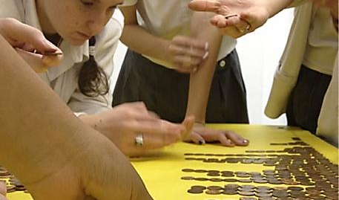
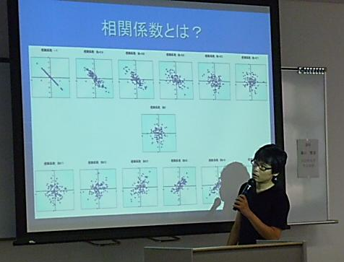
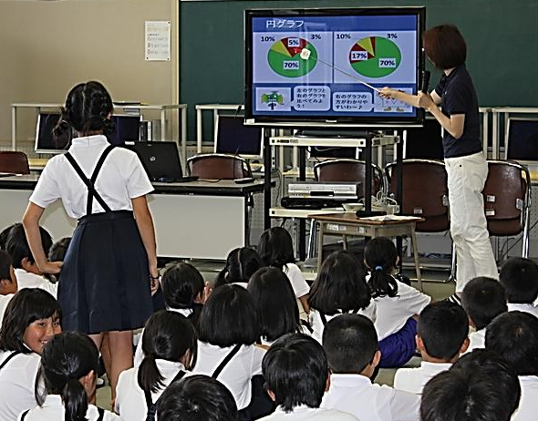
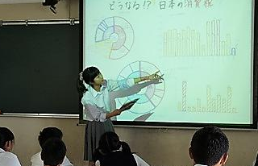
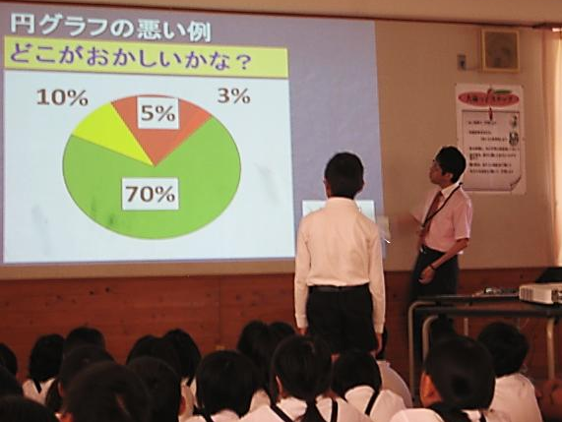
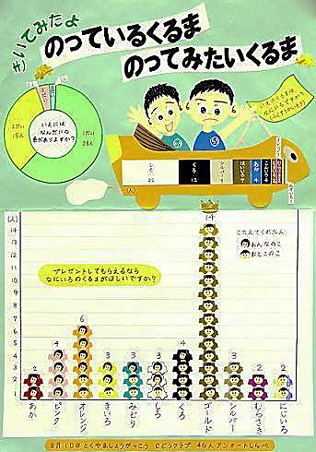
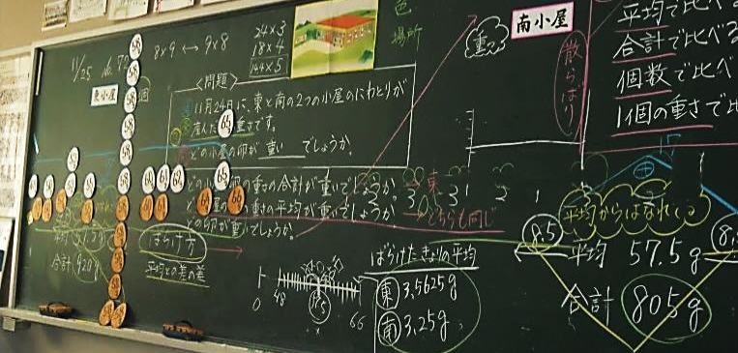
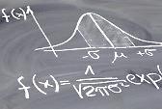
Senior High School Mathematics Teachers’ Difficulty to Teach Statistics:
The Cases of Japan and Thailand
Orlando GONZÁLEZ
IDEC, Hiroshima University
Japan
Masami ISODA
CRICED, University of Tsukuba
Japan
Somchai CHITMUN
Srimahosot School
Thailand
APEC-Tsukuba International Conference IX
University of Tsukuba, Otsuka Campus
Tokyo, Japan – February 11, 2015

Slide 2
Outline
1．Rationale
2．Variability as a Fundamental Idea
3．Statistical Literacy
4. Being a “Data Detective” (Findings & Discussion)
Task 4
Task 5
Task 7
APEC-Tsukuba International Conference IX | Senior High School Mathematics Teachers’ Difficulty to Teach Statistics: The Cases of Japan and Thailand | February 11, 2015 | 1

Slide 3
Rationale
The role of statistics in today’s society is very important at personal, professional, national, global, and even educational levels.
The educational importance of producing students statistically literate is particularly highlighted in the mathematics curricula of Japan and Thailand.
At senior high school level, in the latest Japanese Course of Study (MEXT, 2008, 2009), one of the four strands in the subject of Mathematics is “Analysis of Data” .
In the case of Thailand, its latest Basic Education Core Curriculum (2008) set 6 strands in the subject of Mathematics, being one of them “Data Analysis and Probability”.
APEC-Tsukuba International Conference IX | Senior High School Mathematics Teachers’ Difficulty to Teach Statistics: The Cases of Japan and Thailand | February 11, 2015 | 2

Slide 4
Rationale
Exposure to statistics at secondary school is critical in developing students’ knowledge base and statistical literacy skills (Watson, 2006).
statistics at secondary school mathematics might be the last and only statistics formal program taken by them.
for those students proceeding to tertiary education, exposure to statistics in secondary school would prepare them for statistics in college and university.
Under this scenario, teachers need to be themselves statistically literate, concern that provides clear evidence of the need and importance of conducting the present research.
In 2009: 78 Japanese senior high school teachers at Ibaraki Prefecture.
In 2013: 77 Thai senior high school teachers at SESAO 7.
APEC-Tsukuba International Conference IX | Senior High School Mathematics Teachers’ Difficulty to Teach Statistics: The Cases of Japan and Thailand | February 11, 2015 | 3

Slide 5
Variability as a Fundamental Idea
Ordinary citizens must deal on a daily basis with a large volume of varying information to draw conclusions, make predictions, describe trends, etc. (Garfield & Ben-Zvi, 2008; Shaughnessy, 2007).
Data
Distributions
VARY
Outcomes
Shapes
Samples
Variability is a characteristic of a statistical object which accounts for its propensity to vary or change (Shaughnessy, 2007).
Variability is regarded by many researchers as the very reason for the existence of discipline of statistics (e.g., Moore, 1990; Shaughnessy & Ciancetta, 2001).
APEC-Tsukuba International Conference IX | Senior High School Mathematics Teachers’ Difficulty to Teach Statistics: The Cases of Japan and Thailand | February 11, 2015 | 4

Slide 6
Statistical Literacy
Statistical literacy is the ability to (a) interpret and critically evaluate statistical information, and (b) discuss or communicate our own reactions to such statistical information in everyday and professional contexts (Gal, 2004; Batanero, 2011).
Statistical literacy involves many skills related to variability, such as (Garfield & Ben-Zvi, 2005, 2008):
describing, measuring and representing variability,
using variability to make comparisons and informed decisions,
recognizing variability in special kinds of distributions, and
ability to identify, interpret, read, and explain varying data, in order to make assessments, inferences and/or decisions.
APEC-Tsukuba International Conference IX | Senior High School Mathematics Teachers’ Difficulty to Teach Statistics: The Cases of Japan and Thailand | February 11, 2015 | 5

Slide 7
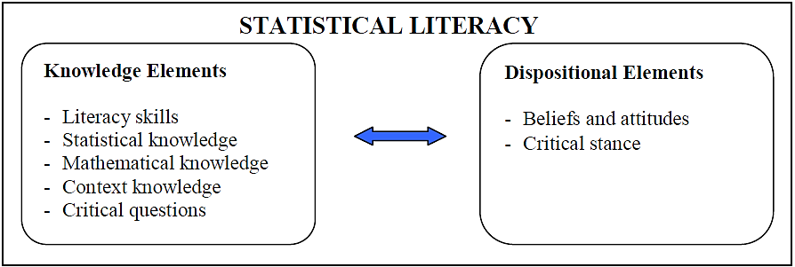
Statistical Literacy
According to Gal (2004), statistical literacy is the result of the interaction between knowledge and dispositional elements.
In our study, we focus on the knowledge elements of statistical literacy.
APEC-Tsukuba International Conference IX | Senior High School Mathematics Teachers’ Difficulty to Teach Statistics: The Cases of Japan and Thailand | February 11, 2015 | 6

Slide 8
Being a “Data Detective”
When analyzing data, the role of a student or a statistician is to be a “data detective”, to uncover the stories that are hidden in the data (Shaughnessy, 2008).
deal with the variation,
look for patterns,
pose their own questions about the data,
interrogate the data,
learn new information about the real world from the data (and vice versa),
generate hypotheses,
make judgments and predictions on the basis of the data.
From a data-detective point of view, students must (e.g., Shaughnessy & Pfannkuch, 2002; Konold & Pollatsek, 2002; Pfannkuch & Ben-Zvi, 2011):
Statistics is not about just numbers but about data, with data being "numbers in context".
Therefore, a continuous dialogue should exist between the data and context (Shaughnessy & Pfannkuch, 2002).
APEC-Tsukuba International Conference IX | Senior High School Mathematics Teachers’ Difficulty to Teach Statistics: The Cases of Japan and Thailand | February 11, 2015 | 7

Slide 9
Being a “Data Detective” – Task 4
Task 4 examines whether teachers are able to think about real-life contexts, and appropriately relate such contexts to particular data representations (Wild & Pfannkuch, 1999; Chance, 2002; Meletiou & Lee, 2003, 2005).
Let's play “data detectives” using Task 4!
APEC-Tsukuba International Conference IX | Senior High School Mathematics Teachers’ Difficulty to Teach Statistics: The Cases of Japan and Thailand | February 11, 2015 | 8

Slide 10
Being a “Data Detective” – Task 4
Let’s start with Variable (a): Age at death of 34 persons.
From context (context knowledge): People usually die when they are older.
⇒Most of the bars should be located at the right end of the X-axis
From interrogating the data (critical question): How should be the shape of the graph?
⇒A left-skewed distribution, with a light left tail and a heavy right tail
⇒ A left-skewed distribution, with few elements on its left tail.
Then, which graph represents Variable (a)?
APEC-Tsukuba International Conference IX | Senior High School Mathematics Teachers’ Difficulty to Teach Statistics: The Cases of Japan and Thailand | February 11, 2015 | 9

Slide 11
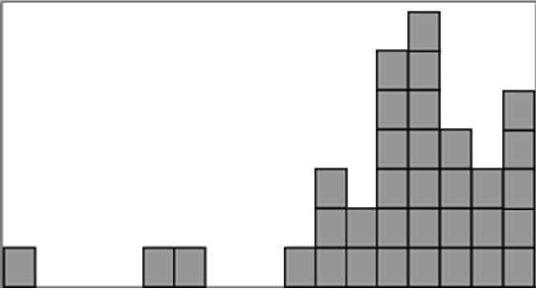
Being a “Data Detective” – Task 4
From the description (statistical knowledge): The sample size is 34.
From the description (mathematical + statistical knowledge): The total count of elements in the graph must be equal to 34.
⇒If we suppose that the smallest bar represents 1 person, then the answer it’s Graph 1!
APEC-Tsukuba International Conference IX | Senior High School Mathematics Teachers’ Difficulty to Teach Statistics: The Cases of Japan and Thailand | February 11, 2015 | 10

Slide 12
Being a “Data Detective” – Task 4
Regarding our survey, 46 out of 78 (58.9%) of the Japanese senior high school teachers correctly matched Variable (a) to Graph 1.
In the case of Thailand, 33 out of 77 (42.9%) of the participants correctly made this match.
Let's continue playing “data detectives” using Task 4!
This time, let’s consider Variable (b): The last digit in the social security number of each of the 40 students in a randomly-selected class.
APEC-Tsukuba International Conference IX | Senior High School Mathematics Teachers’ Difficulty to Teach Statistics: The Cases of Japan and Thailand | February 11, 2015 | 11

Slide 13
Being a “Data Detective” – Task 4
Variable (b): The last digit in the social security number of each of the 40 students in a randomly-selected class.
What is the context here?
⇒Social security numbers (final digit).
What kind of critical questions might be posed here?
⇒How should be the graph of the data distribution?
⇒ Are there any particular characteristics of this kind of distribution?
Understanding the fact that this variable represents social security numbers (final digit) is an important clue!!!
APEC-Tsukuba International Conference IX | Senior High School Mathematics Teachers’ Difficulty to Teach Statistics: The Cases of Japan and Thailand | February 11, 2015 | 12

Slide 14
Being a “Data Detective” – Task 4
What is the context here?
⇒Social security numbers (final digit)
⇒The likely range of this sample is 0 to 9, which means 10 bars.
What kind of critical question might be posed here?
⇒How should be the graph of the data distribution?
⇒ Are there any particular characteristics of this kind of distribution?
This is an example of an uniform distribution, so we should expect a histogram with bars of similar height across the range.
Therefore, Graph 2 corresponds to Variable (b).
APEC-Tsukuba International Conference IX | Senior High School Mathematics Teachers’ Difficulty to Teach Statistics: The Cases of Japan and Thailand | February 11, 2015 | 13

Slide 15
Being a “Data Detective” – Task 4
Regarding our survey, 69 out of 78 (88.5%) of the Japanese senior high school teachers correctly matched Variable (b) to Graph 2.
In the case of Thailand, 31 out of 77 (41.3%) of the participants correctly made this match.
When doing this match, almost 25% of the Thai participants (19 out of 77 teachers) incorrectly matched Variable (b) to Graph 4.
APEC-Tsukuba International Conference IX | Senior High School Mathematics Teachers’ Difficulty to Teach Statistics: The Cases of Japan and Thailand | February 11, 2015 | 14

Slide 16
Being a “Data Detective” – Task 4
33.3% of the Japanese high school teachers (26/78) correctly matched every variable to its corresponding graph.
In the case of Thai teachers, only 16 out of 77 (20.8%) could correctly match every variable to its corresponding graph.
As Gal (2004) points out, two important aspects of the statistical knowledge base are the following:
“Familiarity with basic terms and ideas related to descriptive statistics”, and
“Familiarity with basic terms and ideas related to graphical and tabular displays”.
These aspects, as well as other knowledge components regarding statistical literacy as defined by Gal (2004), seem to need further development in the senior high school teachers at both countries.
APEC-Tsukuba International Conference IX | Senior High School Mathematics Teachers’ Difficulty to Teach Statistics: The Cases of Japan and Thailand | February 11, 2015 | 15

Slide 17
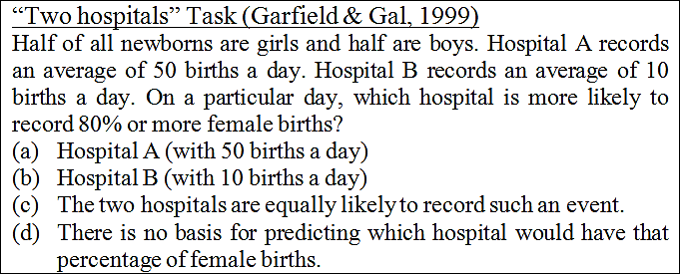
Being a “Data Detective” – Task 5
Task 5 is the "Two Hospitals" Task, which has been used to assess teachers' reasoning about the effect of sample size on sampling variability and estimation of parameters.
Which of the options above is the correct one?
APEC-Tsukuba International Conference IX | Senior High School Mathematics Teachers’ Difficulty to Teach Statistics: The Cases of Japan and Thailand | February 11, 2015 | 16

Slide 18
Being a “Data Detective” – Task 5
Hint: What does “80% or more female births” means?
⇒40 or more girls in Hospital A, and 8 or more girls in Hospital B.
Another hint: Based on your previous answer, what could be a likely (probable) outcome? What could be an unlikely outcome?
Hospital B is more likely to have 80% or more, because:
If you're doing 50 births a day, 40 girls out of 50 seems very unlikely compared to 8 out of 10 (sampling variability).
The larger hospital will have less variability from the expected value of 50% boys and 50% girls, according to the Law of Large Numbers.
APEC-Tsukuba International Conference IX | Senior High School Mathematics Teachers’ Difficulty to Teach Statistics: The Cases of Japan and Thailand | February 11, 2015 | 17

Slide 19
Being a “Data Detective” – Task 5
50% of the Japanese high school teachers (39/78) correctly chose Hospital B.
In the case of Thai teachers, 27 out of 77 (35.1%) made the correct choice.
24.4% of the Japanese teachers (19/78) incorrectly chose Option (c) (both hospitals have the same chance).
33.8% of the Thai teachers (26/77) incorrectly chose Hospital A.
These results show that the surveyed Japanese teachers are mathematical equiprobability oriented.
Thai teachers seems to have an inappropriate interpretation of the Law of Large numbers (namely, they seem to think that the larger number of random trials, the larger probability to deviate from the expected value).
APEC-Tsukuba International Conference IX | Senior High School Mathematics Teachers’ Difficulty to Teach Statistics: The Cases of Japan and Thailand | February 11, 2015 | 18

Slide 20
Being a “Data Detective” – Task 7
Task 7 is a problem in which teachers are required to make appropriate connections between real-life context-free histograms, and their statistical summaries.
Could you match the Variable 5 to its corresponding histogram?
APEC-Tsukuba International Conference IX | Senior High School Mathematics Teachers’ Difficulty to Teach Statistics: The Cases of Japan and Thailand | February 11, 2015 | 19

Slide 21
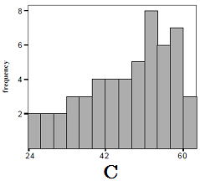
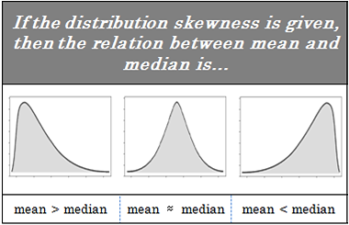
Variable | Mean | Median | Standard Deviation
1 | 50 | 50 | 10
2 | 50 | 50 | 15
3 | 53 | 50 | 10
4 | 53 | 50 | 20
5 | 47 | 50 | 10
6 | 50 | 50 | 5
What is different with Var. 5?
We can notice that only in this case the mean is smaller than the median.
Left-skewed distribution
左に歪んでいる分布
(左方向に裾を引いた分布)
Then, Histogram C corresponds to Variable 5.

Slide 22
Being a “Data Detective” – Task 7
Knowing how variation in the shape of the data distribution affects the position of the mean and the median is fundamental to easily solve this problem.
38.5% of the Japanese high school teachers (30/78) made this match correctly.
In the case of Thai teachers, 31 out of 77 (40.3%) made this match correctly.
Nevertheless, just 6 Japanese (7.7%) and 3 Thai (3.9%) teachers made all the matches correctly.
Teachers’ performance on this task indicates that many of them were unable to relate the variability of the data in a histogram with its summary statistics, particularly features of a data distribution with the shape of its graph.
APEC-Tsukuba International Conference IX | Senior High School Mathematics Teachers’ Difficulty to Teach Statistics: The Cases of Japan and Thailand | February 11, 2015 | 21

Slide 23
Questions and Comments are Welcomed
Thank You for your Attention!
APEC-Tsukuba International Conference IX | Senior High School Mathematics Teachers’ Difficulty to Teach Statistics: The Cases of Japan and Thailand | February 11, 2015 | 22

